Slide 1
New Perspectives on Microsoft Excel 2019

Slide 2
Getting Started with Excel
Module 1

Slide 3
Objectives, Part 1
Open and close a workbook
Navigate through a workbook and worksheet
Select cells and ranges
Plan and create a workbook
Insert, rename, and move worksheets
Enter text, dates, and numbers
Undo and redo actions
Resize columns and rows

Slide 4
Objectives, Part 2
Enter formulas and the SUM and COUNT functions
Copy and paste formulas
Move or copy cells and ranges
Insert and delete rows, columns, and ranges
Create patterned text with Flash Fill
Add cell borders and change font size
Change worksheet views
Prepare a workbook for printing

Slide 5
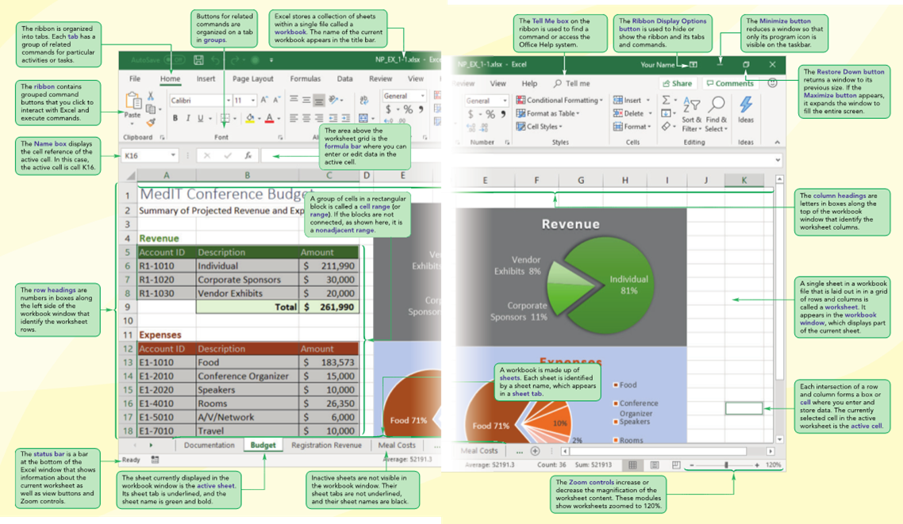
Visual Overview, Part 1

Slide 6
Introducing Excel and Spreadsheets, Part 1
Microsoft Excel (or just Excel) is a program to record, analyze, and present data arranged in the form of a spreadsheet
A spreadsheet is a grouping of text and numbers in a rectangular grid or table
Backstage view, the File tab of the ribbon, contains various screens with commands that allow you to manage files and options for the Excel

Slide 7
Introducing Excel and Spreadsheets, Part 2
Backstage view, the File tab of the ribbon, contains various screens with commands that allow you to manage files and options for the Excel
A template is a preformatted workbook that contains the document design and some content already entered into the document

Slide 8
Introducing Excel and Spreadsheets, Part 3
Excel is an extensive and powerful program supporting a wide variety of commands and tools
If you are unsure about the function of an Excel command or you want information about how to accomplish a task, you can use the Help system
A keyboard shortcut is a key or combination of keys that you press to access a feature or perform a command

Slide 9
Introducing Excel and Spreadsheets, Part 4
A ScreenTip is a label that appears next to an object, providing information about that object or giving a link to associated help topics
If your computer has a touchscreen, another way to interact with Excel is in Touch Mode in which you use your finger or a stylus to tap objects on the touchscreen to invoke a command or tool

Slide 10
Introducing Excel and Spreadsheets, Part 5
The figures in these modules show the screen in Mouse Mode , in which you use a computer mouse to interact with Excel and invoke commands and tools

Slide 11
Exploring a Workbook
A workbook can have two kinds of sheets:
Worksheet contains a grid of rows and columns into which user enters data
Chart sheet provides visual representation of data
Cell reference identifies column/row location
To navigate between worksheets
Use sheet tabs

Slide 12
Closing a Workbook
Once you are finished with a workbook, you can close it. When you close a workbook, a dialog box might appear, asking whether you want to save any changes you may have made to the workbook
If you have made changes that you want to keep, you should save the workbook

Slide 13
Planning a Workbook
Use a planning analysis sheet to define:
Goal or purpose of workbook
Type of data to collect
Formulas needed to apply to data you collected and entered
Appearance of workbook content

Slide 14
Starting a New Workbook
You create new workbooks from the New screen in Backstage view from the Blank workbook template.
On the ribbon, click the File tab to display Backstage view
Click New in the navigation bar to display the New screen
Click the Blank workbook tile

Slide 15
Entering Text, Dates, and Numbers, Part 1
Text data
Combination of letters, numbers, and symbols
Often referred to as a text string
Numeric data
Numerical value to be used in a mathematical calculation
Date and time data
Commonly recognized formats for date and time values
Undoing and redoing an action
Excel maintains a list of actions performed in a workbook during current session

Slide 16
Entering Text, Dates, and Numbers, Part 2
Editing Cell Content
As you work, you might find entries you need to change or correct.
If you want to replace all of the content in a cell, you simply select the cell and then type the new entry to overwrite the previous entry.
If you need to replace only part of a cell’s content, you can work in Edit mode.
If you want to replace only part of a cell’s content, you can switch to Edit mode to make the changes directly in the cell
To switch to Edit mode, you double-click the cell

Slide 17
Entering Text, Dates, and Numbers, Part 3

Slide 18
Entering Text, Dates, and Numbers, Part 4

Slide 19
Entering Text, Dates, and Numbers, Part 5
As you type text in the active cell, Excel tries to anticipate the remaining characters by displaying text that begins with the same letters as a previous entry in the same column
This feature, known as AutoComplete, helps make entering repetitive text easier and reduces data entry errors

Slide 20
Entering Text, Dates, and Numbers, Part 6
Excel recognizes dates in any standard date formats. For example, in Excel, all the following entries represent the same date:
4/6/2021
4/6/21
4-6-2021
April 6, 2021
6-Apr-21

Slide 21
Resizing Columns and Rows, Part 1
A pixel is an individual point on a computer monitor or printout. A column width of 8.43 characters is equivalent to 64 pixels
You can change the width of multiple columns at once. To select a range of columns, click the first column heading in the range, hold down Shift , and then click the heading of the last column or click and drag the pointer over the column headings

Slide 22
Resizing Columns and Rows, Part 2
Column width
Expressed in terms of number of characters or pixels (8.43 characters equals 64 pixels)
Note: Pixel size is based on screen resolution
Row height
Measured in points (1/72 of an inch) or pixels
Default row height: 15 points or 20 pixels

Slide 23
Resizing Columns and Rows, Part 3
Wrapping Text Within a Cell
Wrapping text increases the row height to display any additional new lines added in the cell. Resize the width of column as appropriate.
Select the cells you wish to apply wrapping to.
On the Home tab, in the Alignment group, click the Wrap Text button.
The Wrap Text button is toggled on, and text in the selected cells that exceeds the column width wraps to a new line.

Slide 24
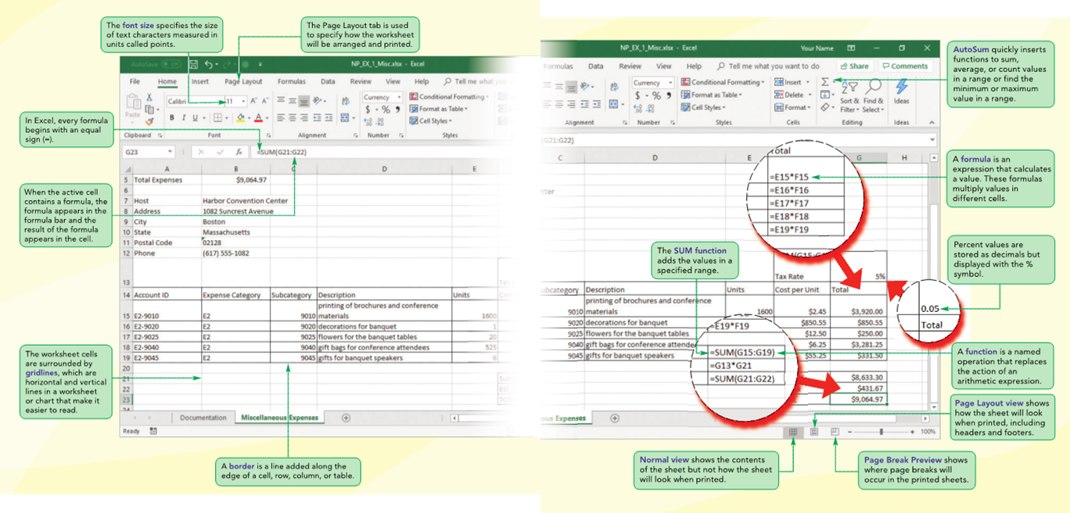
Visual Overview, Part 2

Slide 25
Calculating with Formulas, Part 1
Formula
An expression that returns a value
A formula is written using operators , or mathematical symbols, that combine different values, resulting in a single value that is then displayed in the cell. The most common operators are arithmetic operators that perform mathematical calculations such as addition (+), subtraction (−), multiplication (*), division (/), and exponentiation (^)

Slide 26
Calculating with Formulas, Part 2
Entering a formula
Click cell where you want formula results to appear
Type = and an expression that calculates a value using cell references and arithmetic operators
Cell references allow you to change values used in the calculation without having to modify the formula itself
Press Enter or Tab to complete the formula

Slide 27
Calculating with Formulas, Part 3
Copying and pasting formulas
Cell references adjust to reflect new location of the formula in the worksheet

Slide 28
Calculating with Functions, Part 1
Function
Named operation that returns a value
Simplifies a formula, reducing a long formula into a compact statement; for example, to add values in the range A1:A10:
Enter the long formula: =A1+A2+A3+A4+A5+A6+A7+A8+A9+A10 or
Use the SUM function to accomplish the same thing: =SUM(A1:A10)

Slide 29
Calculating with Functions, Part 2
Fast, convenient way to enter commonly used functions
Includes buttons to quickly insert/generate:
Sum of values in column or row (SUM)
Average value in column or row (AVERAGE)
Total count of numeric values in column or row (COUNT)
Minimum value in column or row (MIN)
Maximum value in column or row (MAX)

Slide 30
Calculating with Functions, Part 3

Slide 31
Calculating with Functions, Part 4
Guidelines for writing effective formulas:
Keep them simple
Do not hide data values within formulas
Break up formulas to show intermediate results
Test complicated formulas with simple values

Slide 32
Modifying a Worksheet, Part 1
Moving and Copying a Cell or Range
Select the cell range to move or copy
Move the pointer over the border of the selection until the pointer changes shape.
To move the range, click the border and drag the selection to a new location. To copy the range, hold down CTRL and drag the selection to a new location

Slide 33
Modifying a Worksheet, Part 2
Or
Select the cell range to move or copy
On the Home tab, in the Clipboard group, click the Cut or Copy button; or right-click the selection, and then click Cut or Copy on the shortcut menu; or press CTRL+X or CTRL+C
Select the cell or the upper-left cell of the range where you want to paste the copied content
In the Clipboard group, click the Paste button; or right-click the selection and then click Paste on the shortcut menu; or press CTRL+V

Slide 34
Using the COUNT Function
Many financial workbooks need to report the number of entries, such as the number of products in an order or the number of items in an expense or revenue category
To calculate the total number of items, you can use the COUNT function

Slide 35
Modifying Rows and Columns
To insert rows and columns into a worksheet:
Select the row or column headings where you want to insert new content
On the Home tab, in the Cells group, click the Insert button; or right-click the selected headings and click Insert on the shortcut menu; or press Ctrl+Shift+=
To delete rows or columns:
Select the row or column headings for the content you want to delete
On the Home tab, in the Cells group, click the Delete button; or right-click the selecting headings, and then click Delete on the shortcut menu; or press CTRL+−

Slide 36
Using Flash Fill
Flash Fill enters text based on patterns it finds in the data
Flash Fill works best when the pattern is clearly recognized from the values in the data

Slide 37
Formatting a Worksheet
Adding Cell Borders
You can make spreadsheet content easier to read by adding borders around the worksheet cells
Changing the Font Size
The size of the text is referred to as the font size and is measured in points. The default font size for worksheets is 11 points, but it can be made larger or smaller as needed

Slide 38
Printing a Workbook, Part 1
Changing worksheet views
Normal view
Page Layout view
Page Break Preview

Slide 39
Printing a Workbook, Part 2
Changing the Page Orientation
Portrait orientation (default)
Page is taller than wide
Landscape orientation
Page is wider than tall

Slide 40
Printing a Workbook, Part 3
Scaling resizes the worksheet to fit within a single page or set of pages
There are several options for scaling a printout of a worksheet
You can scale the width or the height of the printout so that all the columns or all of the rows fit on a single page

Slide 41
Printing a Workbook, Part 4

Slide 42
Viewing Worksheet Formulas
If you print the worksheet while the formulas are displayed, the printout shows the formulas instead of the values
To make the printout easier to read, you should print the worksheet gridlines as well as the row and column headings so that cell references in the formulas are easy to find in the printed version of the worksheet

